Slide 1
Decision Tree
Hyper Parameters:
None
Accuracy: 93.52%
Precision: 93% (dissatisfied), 94% (satisfied)
Recall: 92% (dissatisfied), 95% (satisfied)
F1-score: 93% (dissatisfied), 94% (satisfied)
Notes:
Accuracy: the model correctly predicts about 93.52% of the instances in the test set
Confusion Matrix:
True Negatives (TN): 5428 (dissatisfied customers correctly predicted as dissatisfied)
False Positives (FP): 454 (dissatisfied customers incorrectly predicted as satisfied)
False Negatives (FN): 385 (satisfied customers incorrectly predicted as dissatisfied)
True Positives (TP): 6682 (satisfied customers correctly predicted as satisfied)
Classification Report:
Precision – for class 0 (customer is dissatisfied) the precision is 93% and for class 1 (customer is satisfied) the precision is 94%
Recall – for class 0 (customer is dissatisfied) the recall is 92% and for class 1 (customer is satisfied) the precision is 95%.
F1-score – for class 0 (customer is dissatisfied) f1-score is 93% and for class 1 (customer is satisfied) f1-score is 94%
Weighted average – both macro and weighted average for precision, recall, and f1-score are high at 93-94%
Observations:
Decision tree model demonstrates strong performance with high precision, recall, and f1-scores. The model is effective at classifying both satisfied and dissatisfied customers
The confusion matrix shows a relatively small number of misclassifications (454 false positives and 385 false negatives), indicating that the model makes very few errors
Precision and recall are marginally higher for class 1, meaning the model is slightly better at identifying satisfied customers than dissatisfied ones

Slide 2
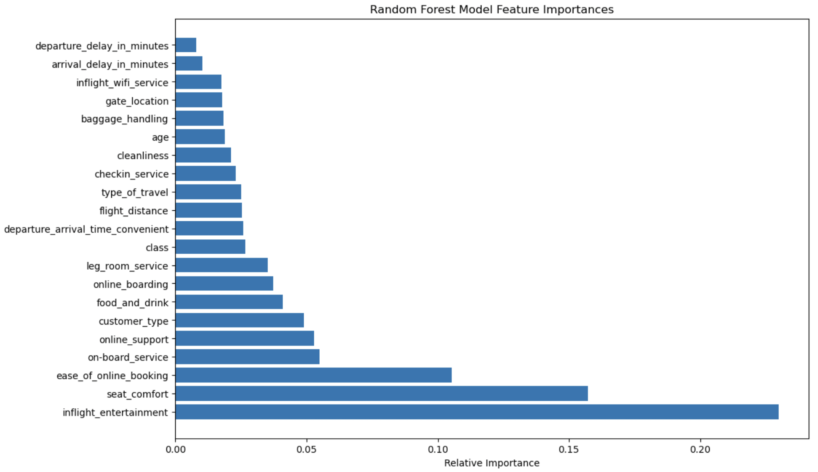
Random Forest
Hyper Parameters:
n_estimators: 10
max_depth: 20
min_samples_split: 10
min_samples_leaf: 4
Accuracy: 94.96%
Precision: 94% (dissatisfied), 96% (satisfied)
Recall: 95% (dissatisfied), 95% (satisfied)
F1-score: 95% (dissatisfied), 95% (satisfied)
Notes:
Accuracy: the model correctly predicts about 94.96% of the instances in the test set
Confusion Matrix:
True Negatives (TN): 5608 (dissatisfied customers correctly predicted as dissatisfied)
False Positives (FP): 274 (dissatisfied customers incorrectly predicted as satisfied)
False Negatives (FN): 378 (satisfied customers incorrectly predicted as dissatisfied)
True Positives (TP): 6689 (satisfied customers correctly predicted as satisfied)
Classification Report:
Precision – for class 0 (customer is dissatisfied) the precision is 94% and for class 1 (customer is satisfied) the precision is 96%.
Recall – for class 0 (customer is dissatisfied) the recall is 95% and for class 1 (customer is satisfied) the precision is 95%
F1-score – for class 0 (customer is dissatisfied) f1-score is 95% and for class 1 (customer is satisfied) f1-score is 95%
Weighted average – both macro and weighted average for precision, recall, and f1-score are high at 95%
Observations:
Random forest model demonstrates strong performance with high precision, recall, and f1-scores. The model is effective at classifying both satisfied and dissatisfied customers.
The confusion matrix shows a relatively small number of misclassifications (274 false positives and 378 false negatives), indicating that the model makes very few errors
Precision is slightly higher for class 1, meaning the model is slightly better at identifying satisfied customers than dissatisfied ones
Decision Tree vs. Random Forest:
Overall, random forest is better at generalizing and makes fewer misclassifications than the decision tree model. The random forest model has a higher accuracy (94.96%) than the decision tree model (93.52%)
Both classes (satisfied and dissatisfied) have strong performance in precision, recall, and f1-score. However, the random forest model has better class performance than decision tree model – recall for dissatisfied customers is 95% using random forest, which is notably higher than the recall of 92% using the decision tree model.
Random forest has fewer false positives and false negatives compared to the decision tree model; random forest is better at avoiding both types of errors

